Slide 1
CHEMICALS & CANCER:
The 250-year Journey from the Chimney Sweeps of London to the Modern Age of Risk Analysis and Regulation
G. Malcolm Trout Annual Lecture
Department of Food Science and Human Nutrition
Michigan State University
16th September, 2019
Joseph V. Rodricks

Slide 2
Thanksgiving, 1959
Dr. Arthur Fleming, Secretary of HEW (now HHS) told Americans that it would be:
“prudent to avoid cranberry sauce”
Trace amounts of the herbicide aminotriazole had been detected in the sauce
-- NOT KNOWN TO CAUSE CANCER IN HUMANS
-- DID CAUSE CANCER IN ANIMALS
SALES OF SAUCE
Cranberry Sauce

Slide 3
“THE DOSE MAKES THE POISON” (Paracelsus, 16TH C.)
The dose of aminotriazole that caused thyroid tumors in rats…
…was equivalent to the human dose that would result from consuming 1,500 cans of cranberry sauce.
PUBLIC REACTION
RIDICULE FEAR

Slide 4
THE CRANBERRY SAUCE STORY Many Repeat Performances
Alar in apples Asbestos
Ethylene dibromide in flour Benzene
Diethystilbestrol (DES) in meat N-Nitrosamines
Saccharin in soft drinks Arsenic
Vinyl chloride in food packaging Acrylamide
Polycyclic aromatic hydrocarbons (PAHs) in grilled foods TRIS in pajamas
Aflatoxin in peanuts and grains etc.
PCBs in everything etc.

Slide 5
Chemicals and cancer
How did we arrive at where we are?
How do we understand where we are?
How do we deal with where we are?
Now and in the future?
TO KEEP IN MIND: Chemicals are not the only sources of cancer risk.
Sunlight
Ionizing Radiation
Diet
Tobacco (smoke contains thousands of chemicals)
Viruses
Genetic predisposition
MOST CANCERS ARE MULTIFACTORIAL, ALTHOUGH IN SOME CASES A SINGLE FACTOR MAY BE OF PRIMARY IMPORTANCE

Slide 6
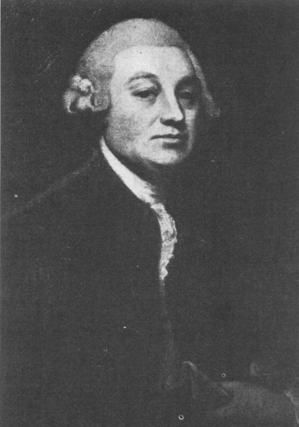
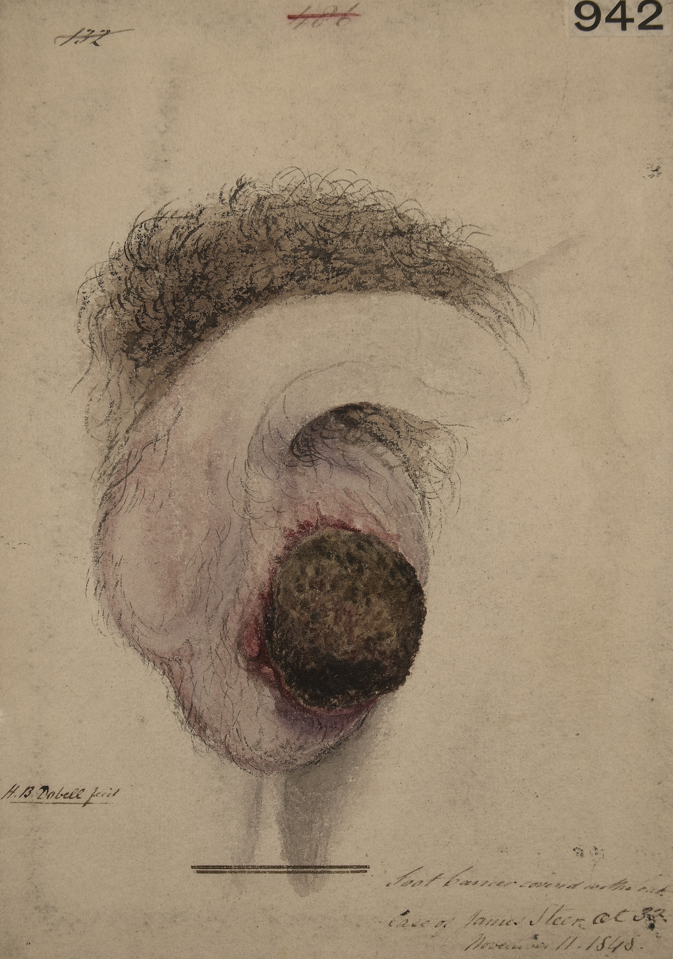
The chimney sweeps of 18th century london
“It is a disease [the chimney-sweep’s cancer] which makes its first appearance on the inferior part of the scrotum, where it produces a painful, ragged, ill-looking sore with hard rising edges. The trade call it the soot wart.”
Percival Pott, 1775
First report of an occupationally related cancer
AND MORE IMPORTANTLY,
The first report of an external cause of cancer.

Slide 7

Cancer derivation
CANCER IS A WORD IN THE ENGLISH LANGUAGE DERIVED FROM THE GREEK WORD FOR CRAB (KARKINOS), WHICH WAS FIRST USED BY THE GREEK, HIPPOCRATES (460-375 BCE) TO DESCRIBE THE DISEASE, AND SUBSEQUENTLY TRANSLATED (AROUND 47 AD) BY THE GRECKO-ROMAN PHILOSOPHER, CELCUS, TO THE LATIN EQUIVALENT, CANCER.
GALEN (Claudius Galenus) 130-210 (Greek who lived in Rome) said CANCER WAS CAUSED BY IMBALANCES IN THE FOUR BODY “HUMORS:”
-- Blood, Phlegm, Yellow bile, Black bile
Excess melancholia cancer

Slide 8
Galen’s view was dogma
UNTIL -- Pott’s observations began to overturn the views of Galen
Pott’s work reflected the new prominence of the empirical method – resulting from the scientific revolution of the 16th – 18th Century that formed the philosophical thinking of the Age of Enlightenment
Galileo
Newton
Harvey
Bacon
Descartes
Hume

Slide 9
Pott’s Soot
Pott was more interested in describing the scrotal cancers than in their cause – although he advocated hygienic measures to reduce exposure.
The chemical composition of soot and similar materials was not uncovered until the 1920s-1930s in Londin by:
Ernest Laurence Kennaway
Isidore Hieger
PAHs – Polycyclic Aromatic Hydrocarbons – identified as the carcinogenic components of soot
Benz[a]pyrene
Dibenzo[a,h]anthracene

Slide 10
Soot/Coal Tar/Coal Gas
Coal Tar (condensate)
heat cool
COAL Volatile Chemicals
absence
of oxygen Coal Gas
By 1850 Coal Gas production was ubiquitous in North America and Europe.
and
Coal Tar became the major source of starting materials for the rapidly growing chemical industry
-- and remained the major source until WWII, when petroleum products replaced it.

Slide 11
Soot/Coal Tar/and other combustion products
All contain PAHs
and
It became clearer by the early 20th century that many occupational skin cancers were caused by these materials.

Slide 12
Chemicals and Cancer FROM POTT TO THE 1950s
Lung and skin cancers in certain mining and smelting operations in Germany and England – ARSENIC
Skin cancers related to an oral medication (Fowler’s Solution)
As₂O₃
[First non-occupational cause]
Kangri cancers among Kashmiris – skin of abdomen
[Live coals carried in a basket near abdomen (PAHs)]
1879
(Hartnig & Hesse)
1887
(Hutchinson)
1900
(Neve)

Slide 13
Chemicals and Cancer FROM POTT TO THE 1950s
Ludwig Rehn – German physician
The development of synthetic organic chemistry (1860) and the availability of coal tar gave rise to a large and rapidly growing chemical industry (1870-WWII):
e.g., DuPont; I.G. Farben; Imperial Chemical Industries
Rehn, 1895: “Bladder tumors in fuchsin workers”
“I am going to tell you about a number of illnesses which, with a high degree of probability can be attributed to a chemical stimulus.”
“… it is extremely striking that out of 45 workers at most who were employed in the fuchsin room, three were affected with bladder tumors.”

Slide 14
The Age of experimental chemical carcinogenesis
“Cancer was produced! Katsusaburo Yamagiwa (1863-1930)
Proudly I walk a few steps” Koichi Ichikawa (1888-1948)
Journal of Cancer Research (1918) Tokyo Imperial University
“Experimental study of the pathogenesis of carcinoma.”
Coal tar in a solvent – painted onto surface of rabbit ears “every two or three days” produced what the authors called “folliculoepitheliomata”
- 30 days to appearance of first tumors
- many malignant growths after 150 days
First experimental production of tumors involving chemical exposure
AND
IT TOOK A VERY LONG TIME
The Kennaway Lab (London) – discovery of PAH content – made similar demonstrations in 1920s

Slide 15
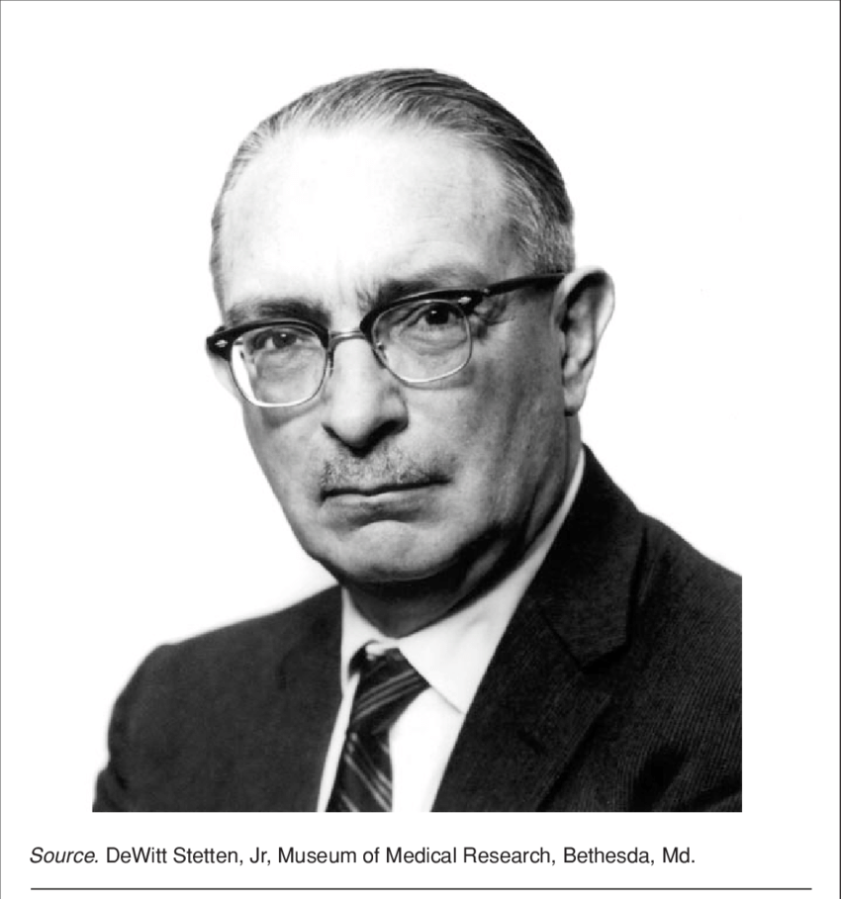
1920s to 1950s
Study of experimental carcinogenesis accelerated
PAHs, Azo dyes
Epidemiologic methods improved; several occupational carcinogens identified
AND
Dr. Wilhelm C. Heuper

Slide 16
Wilhelm C. Heuper
“ A characteristic that Bill Hueper possesses in high degree…is his ability to shock and alarm.
Many of Hueper’s opponents found Hueper to be “abrasive, controversial and irritating.”
Harold Stewart (preeminent expert on tumor pathology)
At National Institutes of Health ceremony to honor the contributions of Hueper to cancer prevention.
The German-born (1894) and educated (M.D. 1920, Kiel) Hueper became Chief of the new National Cancer Institute, NIH, Environmental Cancer Section (1939) and remained there until 1964.

Slide 17
Hueper was the first “scientist-activist” in the field of chemicals and cancer
He got involved in a huge amount of research and almost all of it generated significant controversy.
DuPont dye manufacture – beta-naphthylamine and bladder cancers in workers (1930s)
Claimed publicly that DuPont tried several times to thwart his efforts
Lung cancer excess in chromium manufacturing facility in Baltimore
Dozens of experimental demonstrations of carcinogenicity
Published his work and his concerns about carcinogens in the environment in scientific journals and many publications that he thought would get his views a wide audience
including the Police Gazette

Slide 18
Hueper’s Major Publication chemical carcinogenesis and cancer (1964, with W.D. Conway)
Seven hundred pages, of which about 100 are devoted to “Preventative, Legal and Social Aspects”
“It seems that the early period of chemical conquest of the human environment with its associated confusion, disorder, and lack of control, is drawing to a close and that mankind, to escape from becoming entangled in the new hazards of a self-created pathogenic chemical jungle, has to advance into the second orderly and legalistic phase of this development. With courage and patience, fairness and decency to all, we shall succeed in making a better world and to provide maximal safety to all people as far as such a goal is attainable to man.”
In the end, Hueper was enormously influential

Slide 19
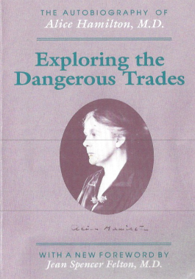
And we should not forget Dr. Alice Hamilton (1870–1972)
Pioneering work in occupational medicine.
Investigated and called to national attention the plight of workers exposed to lead, benzene, and other hazardous substances.
The need to prevent occupational illness was an early incentive for learning about toxicity through animal studies.

Slide 20
Earliest US Law Pertaining to Chemical Toxicity
Regulatory Enforcement
1890s-1910
Federal Law
1906 Pure Food & Drug Act
Bureau of Chemistry, USDA (Harvey Wiley)
Social, Political Activism
Foods & drugs – shall not contain adulterants that may cause harm
Burden of showing adulteration on government
Wiley’s Poison Squad begins to assess safety
1916 Supreme Court: animal data sufficient to show a substance may cause harm

Slide 21
House select committee to investigate the use of chemicals in food products 1950-1960
Chair: Congressman James Delaney (D, NY)
Major amendments to the US Food and Drug Act (1906)
Placed upon manufacturers the burden of demonstrating a SAFETY of substances to be intentionally introduced into food - Direct Food Additives
and
Indirectly introduced substances
Substances migrating from packaging and other materials contacting food
Veterinary drugs used in food-producing animals
Pesticides used on food crops

Slide 22
By the 1950s: Prevailing View in Public Health Communities
Chemicals induced toxicities through biological mechanisms involving thresholds.
Toxicity-free levels must exist
Carcinogens were the exception to this rule.
No safe levels can be identified
All the food-related laws enacted during the 1950s included Congressman Delaney’s clause, strictly forbidding the addition to food, in any amount, of chemicals shown to induce cancers in humans OR animals.

Slide 23
1957 Congressman Delaney introduced the following language into new food additive amendments
“The Secretary* shall not approve for use in food any chemical additive found to induce cancer in man, or, after tests, found to induce cancer in animals”
The Delaney Clause
First law explicitly focused on carcinogens
*Refers to the Secretary of HEW (HHS), to whom the Commissioner of FDA reports

Slide 24
The Delaney Clause
Many experts testified before the Committee, and most favored the Clause’s language [Wilhelm Hueper was, of course, among them].
The Clause had impact well beyond its intended application.

Slide 25
Arnold Lehman & O. Garth Fitzhugh (FDA, 1950s)
ADI: the Allowable Daily Intake
Published the method that would be followed to establish safe levels of human intake for chemicals introduced into food.
As long as human exposures to a chemical did not exceed the ADI, the legal requirement of practical certainty of no harm would be satisfied.
No ADI would be established for any chemical that caused cancer.
This use of the ADI and the zero-tolerance for carcinogens were consistent with new food law requirements.

Slide 26
ADI – Derivation
Starting point: animal toxicity data or epidemiology data
Identify highest dose exhibiting no toxic-effect (NOAEL)
NOAEL is threshold dose for the group studied.
But for a large, diverse human population:
1 Average human assumed to be 10x more sensitive than experimental animals.
2 Threshold doses should vary in human population (10x).
ADI = NOAEL
10x10
Lehman – Fitzhugh called the divisors Safety Factors.

Slide 27
What Does the ADI Tell Us?
Only that exposures at and below it are probably not very risky.
The ADI and its equivalent measures*
are not Risk measures
No information is provided regarding the probability of a toxic response at the ADI.
ADI’s and RfD’s are not truly bright lines between safe and unsafe exposures, yet typically applied as if they were.
*
What EPA came to call toxicity Reference Doses (RfD’s) and Reference Concentrations (RfC’s)

Slide 28
But Delaney gets complicated
For DIRECT ADDITIVES, enforcement is simple.
For INDIRECT ADDITIVES, not so easy.
The example of Diethyl Stilbestrol (DES)
Synthetic estrogen introduced in 1949 to promote growth in food-producing animals
Carcinogen
Residues could be detected in meat
Industry convinced congress to modify law and allow use of DES
“If no residue is found by a method of analysis approved by FDA”
The DES PROVISO

Slide 29
The “des proviso” seemed to make sense
Until we learned from analytical chemists that
we can never be certain there is no residue
We can only be certain there is no residue at a level greater than the limit of detection (LOD) of whatever analytical method we are using.
LODs vary and chemists are always developing methods with lower and lower LODs
HOW DO WE DECIDE HOW MUCH RESIDUE WE CAN IGNORE?

Slide 30
THE DES RESIDUE PROBLEM IS ILLUSTRATIVE OF MANY DEVLOPING DURING THE 1970s
More and more carcinogens in foods, air, water, consumer products, workplaces.
They were either ignored
OR
Regulation was based on the principle:
“If it can be detected, it should not be allowed”
“If we cannot detect it, it’s OK.”
SAFETY WAS A FUNCTION OF ANALYTICAL DETECTION LIMITS
???

Slide 31

Silent Spring: Elixirs of Death
“
For the first time in the history of the world, every human being is now subjected to contact with dangerous chemicals from the moment of conception to death.
”
(Chapter 3)

Slide 32
Silent Spring: One in Every Four
“
The most determined effort should be made to eliminate those carcinogens that now contaminate our food, our water supplies, and our atmosphere, because these provide the most dangerous type of contact—minute exposures, repeated over and over throughout the years.
”
(Chapter 14)
EPA was created in 1970

Slide 33
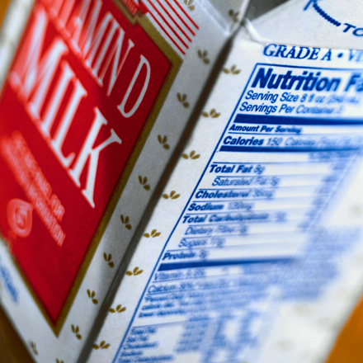
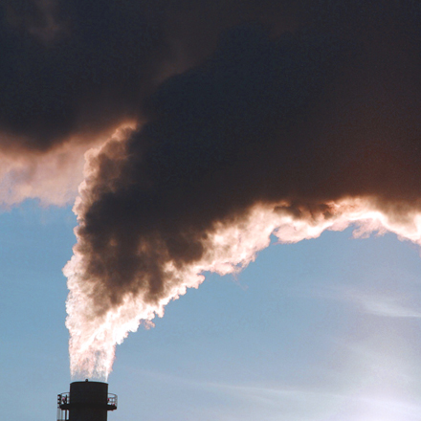
The Situation for Regulators in the 1970s
AVOIDABLE CHEMICAL EXPOSURES | UNAVOIDABLE CHEMICAL EXPOSURES
Substances intentionally added to foods and other products | Substances that have become contaminants of the environment
Addition can simply be halted if safety is in question. The ADI or RfD or RfC readily function as safety criteria. The zero tolerance approach can be applied if any such chemical is found to be a carcinogen. | Exposures can be reduced but not easily eliminated. Exposures to carcinogens can be reduced, but there is no way to determine whether any particular reduction achieves adequate health protection.

Slide 34
Carcinogen Risk
BENZENE
VINYL CHLORIDE
AFLATOXIN
The problem could no longer be ignored.
EPA and FDA began adopting methods to estimate low-dose cancer risks.
The no-threshold assumption was adopted.
A linear dose-response model was adopted.
Upper bounds on low-dose cancer risk were developed.
Regulation based on limiting exposures to avoid specified levels of risk
More potent carcinogens more stringently regulated than less potent ones
RISK= Probability of cancer development
DIMETHYLNITROSAMINES
DES
ASBESTOS
PAHs

Slide 35
Regulatory Applications of Cancer Risk Assessments
Began to take on these forms during the late 1970s/early 1980s and remain in place today!
AVOIDABLE EXPOSURES | UNAVOIDABLE EXPOSURES
Risk had to fall below a de minimis level* (too small to be of consequence). | Applications of different approaches to exposure control would lead to different degrees of risk reduction (health benefit) at different costs. This approach allowed distinctions to be made among the cost-effectiveness of different approaches to regulation. Risks remaining after regulation must be sufficiently small to ensure a large degree of health protection, but do not need to reach de minimis levels.
Except where Delaney Clause applies.

Slide 36
Example -- DES
FDA required that levels in meat not exceed the level that would, when consumed by humans, create a LIFETIME CANCER RISK LESS THAN ONE-IN-ONE MILLION!
For DES, that intake is less than 1 microgram/day
Manufacturers would have to develop analytical methods capable of detecting the “safe” level in meat
AND
Show that “NO RESIDUE” could be detected using that method.
Ultimately, DES use was banned in 1979.

Slide 37
The New York Times Editorial on DES (April 30, 1973)
“Obviously, no saving in meat prices can justify a real risk of cancer in the food Americans eat. But how real is the risk from which the F.D.A. has now begun to protect the community? The F.D.A. has reported that its extremely sensitive analytical equipment has detected DES on the order of magnitude of 120 parts per trillion in the animal tissue examined. Such sensitivity in measuring infinitesimal quantities is a respectable scientific feat, but how meaningful is it as a guide to the public? Is there a significant—even an appreciable—risk of anyone getting cancer from eating meat containing so tiny a quantity of DES? How does the “risk” the F.D.A. has moved against compare with the risk of breathing normal polluted air in Manhattan or downtown Washington, D. C.—or with the risk of having a chest X‐ray or smoking a single cigarette?”

Slide 38
Carcinogen risk assessment – introduced by FDA and EPA in 1970s
The period from 1974-1984 was one of continuing controversy.
The scientific standing of new methods for carcinogen risk assessment was under constant debate, with participants from every affected sector
Under the Carter administration (EPA, FDA, OSHA, CPSC, NCI)
A federal working group developed and published the first comprehensive guidance on the basis for , content of, and uncertainties associated with risk assessment (1979).
- But the debate continued…

Slide 39
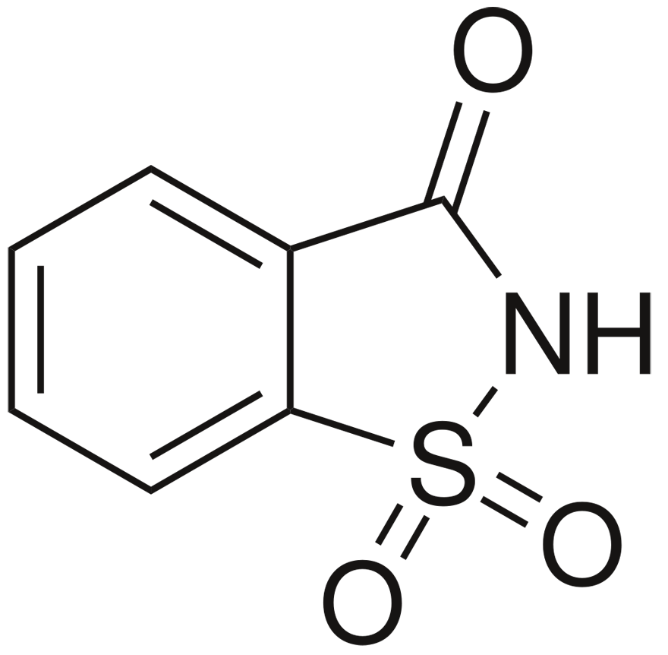
Controversies Mid 1970s to Early 1980s
The saccharin disaster – 1976*
Quantification of cancer risk
Too many untestable assumptions!
Too risky!
Overly cautious!
Risk assessments manipulated by regulatory scientists to achieve desired outcomes.
U.S. Congress persuaded to call for a National Academy study.
The “Red Book” was the result.
*The equivalent of 800 cans of diet soda caused bladder cancer in rats!

Slide 40
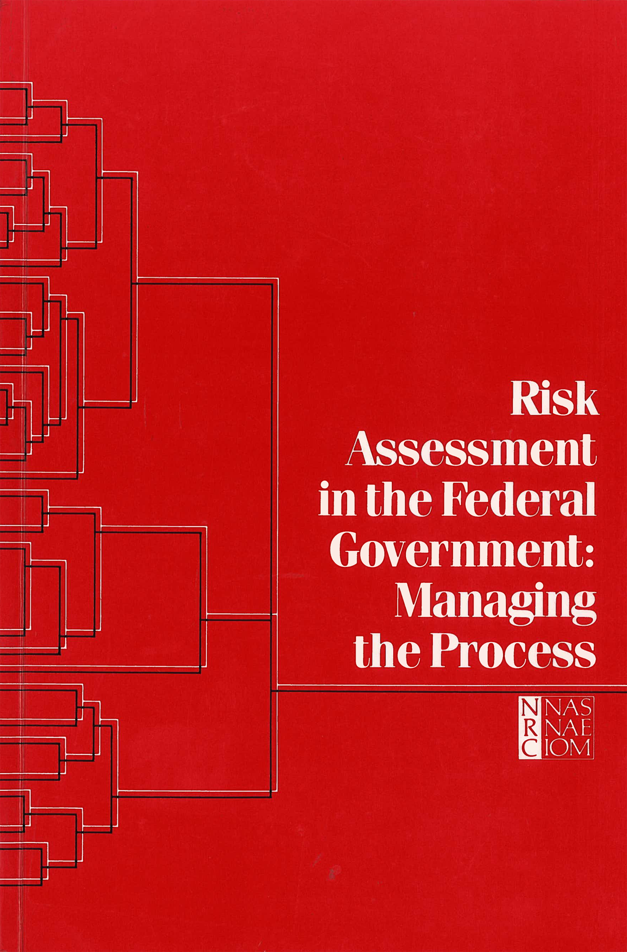
U.S. National Academy of Sciences
The Red Book
What did the report really say?
Why was it important?
1983

Slide 41

Risk Analysis
RISK MANAGEMENT
RESEARCH
Toxic or other hazardous properties of environmental agents*
Human and environmental exposures
Decisions to protect health, environment
Restrictions on exposures
Warnings
Education
Required technical controls
RISK ASSESSMENT
RISK COMMUNICATION
Agents can be chemical, biological, physical.
Driven by legal requirements and generally recognized standards of care.

Slide 42
Risk Assessment
RISK ASSESSMENT:
“
A standardized framework within which research information is organized, evaluated, and put into a form useful for decisions about threats to health, safety, environment.
”
National Academy of Sciences, 1983
Risk Assessment in the Federal Government: Managing the Process

Slide 43
The Problem
Data collected about the hazards of specific agents: epidemiological/experimental
What can be said about the probability that the hazardous properties of those agents will be expressed in:
other populations
exposed under other conditions?
BUT:
Requires extrapolation beyond data

Slide 44
The Red Book Solution: Explicit Guidelines Essential
Science
(Unavoidable) inferences beyond the science
What is the most reliable evidence concerning hazard, dose-risk relationships, and exposure?
What evidence will be used for risk assessment?
How will uncertainties be dealt with?
What options are available to deal with the great unknowns of:
Interindividual Variability
Interspecies Variability
Low-Dose risks?
What options are available to deal with the unknowns in exposure assessment?
What options will be selected for general use in risk assessment?*
THE DEFAULTS
Under what circumstances can one or more of the selected options be replaced by scientific data?

Slide 45
Post-redbook
Risk-based Regulation is the norm
Practice remains imperfect
Many improvements in risk assessment based on increased understanding of mechanisms involved in carcinogenesis
Practice remains imperfect
Much advocacy for hazard-based regulation
Most laws require risk-based regulation
Development of new high-throughput in vitro assays for toxicity testing
How to assess risk based on such tests?
But one chemical at a time is not a sustainable approach.

Slide 46
Risk Analysis
RESEARCH & TESTING
RISK ASSESSMENT
RISK MANAGEMENT
UNCERTAINTY ANALYSIS
RISK COMMUNICATION
Society for Risk Analysis
Every imaginable source of risk to health and well-being is now subject to increased scientific scrutiny with increasingly rigorous methods

Slide 47
Current thinking about causes
80-90% of cancers are of environmental origin (anything not purely hereditary: diet, smoking, occupation, pollutants, etc.
Most cancers are not caused by individual factors, but by several, operating over long periods of time. Each of these causes can be said to increase risk of cancer development
In some cases, a single factor may be so important it can be considered the cause. Cigarette smoking is the prime example.
Because of this, prevention is difficult.* But we can reduce risk!
Except for cancers related to smoking or sun exposure.

Slide 48
Sources of Chemicals
Agriculture/ Forestry
Petroleum
Mining
Fuels
Petrochemicals
Minerals, Metals
By-Products used to make thousands of chemicals
Tens of thousands of chemicals prepared by synthesis
There are more than 80,000 chemicals in commerce + Hundreds of thousands naturally present in diet and other sources

Slide 49
Environmental Pollution
Mining Petroleum Agriculture
OCCUPATIONAL EXPOSURES
ENVIRONMENT
releases
BURNING OF FUELS, etc.
Thousands of combustion products, depends on what you burn
Manufacture
releases
Air
Water
Food
Soils
Distribution
releases
TOBACCO
4000-5000
combustion products
Use
releases
Disposal
releases

Slide 50
Cancer Risk Factors
Smoking
Diet
Alcohol abuse
Chemical carcinogens (occupational, environmental, product exposures)
Ionizing radiation
Certain medicines and diagnostic devices that emit radiation
Sunlight (UV radiation)
Certain infectious agents

Slide 51
Big question
WHAT ARE THE RELATIONSHIPS BETWEEN THE RISKS OF INDIVIDUAL CARCINOGENS AND THE RISKS ASSOCIATED WITH DIET AS A WHOLE, SMOKING, AIR POLLUTION, AND OTHER MAJOR RISK FACTORS?
IS THIS A CHALLENGE WORTHY OF PUSUIT?
“More than 80,000 new cancer cases are estimated to be associated with suboptimal diet among US adults in 2015….”
Zhang et al. (2019)

